Slide 1

Introduction to ROS Final Presentations RoboDog
Team 28
Lin Run, Zhang Yihan, Xin Yutong
02,08,2023 Munich

Slide 2
Main Work
Map perception
Depth information -> Point cloud ->voxel mesh
Path planner
Cost map
Global planner
Path generation
Trajectory planner
Path tracking
Trajectory discretization
State machine
Determine the transition between different states
Controller
Calculate the desired distance and the yaw angle
Determine control modes in different situations
Introduction to ROS| Team 28

Slide 3
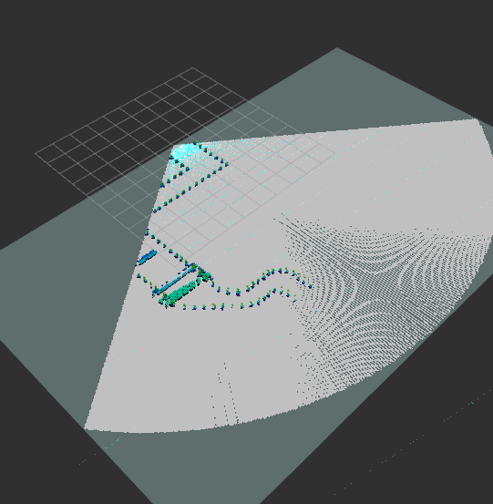
Perception (Which has been done in the mid-term)
depth_image_proc/point_cloud_xyz -> Depth information into point clouds
OctoMap -> Occupancy Grid/Map
Introduction to ROS| Team 28

Slide 4
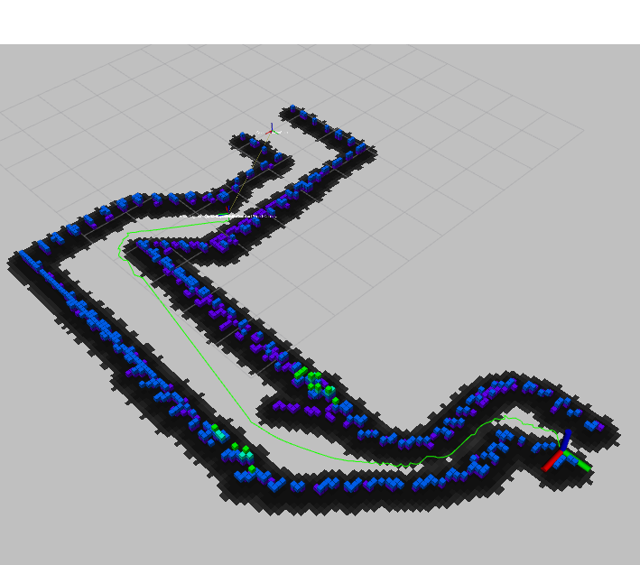
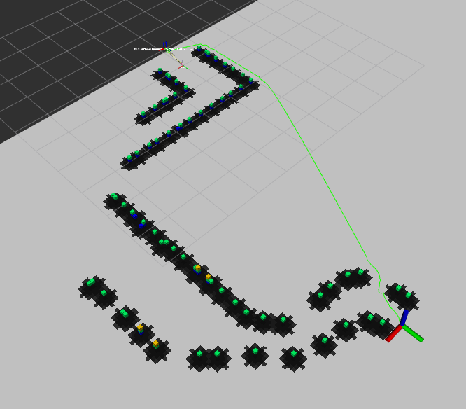
Path planner – move_base
Projected map
Goal
/Move_base_RoboDog
Cost map
Global planner
Introduction to ROS| Team 28

Slide 5
Trajectory planner
Subscribe to “/move_base_Robodog/NavfnROS/plan”
Always send starting point coordinates if RogoDog hasn't reached the starting point
Filter out target points located in front of RoboDog
Meanwhile, choose the point 0.5-1.0 away from RoboDog as the target point
Publish the target point in topic “/desired_state”
A series of target points
PathPlanning_node
/path
/desired_state
Introduction to ROS| Team 28

Slide 6

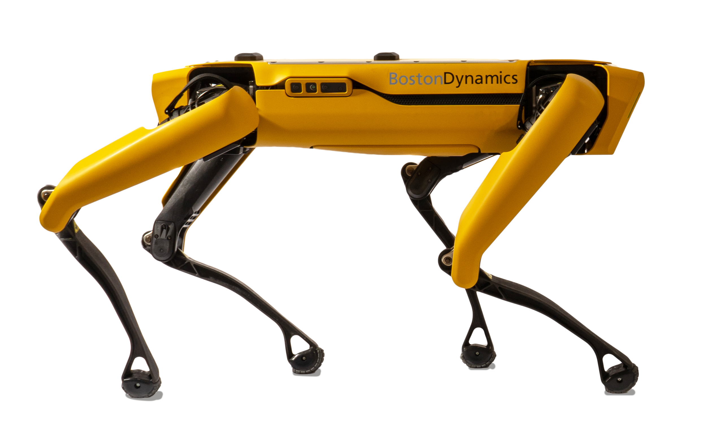
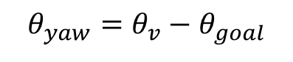
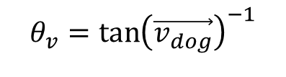
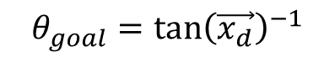
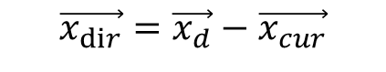

Controller -- Desired yaw angle and distance
$$\vec{x_{dir}}=\vec{x_{d}}−\vec{x_{cur}}$$
Current goal
yaw angle
$$θ_{goal}=\tan{{\left(\vec{x_{d}}\right)}^{−1}}$$
v_dog
$$θ_{v}=\tan{{\left(\vec{v_{dog}}\right)}^{−1}}$$
$$dis=\left|\vec{x_{dir}}\right|$$
RoboDog
$$θ_{yaw}=θ_{v}−θ_{goal}$$
Introduction to ROS| Team 28
$$θ_{goa}l=\tan{{c^{′}}^{−1}}$$

Slide 7
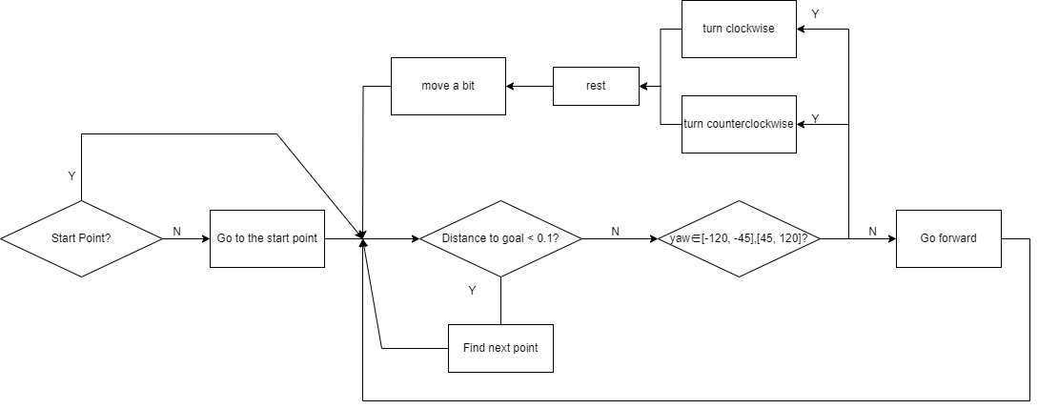
State Machine
Stabilize the orientation
Where’s the step and slope detection?
Introduction to ROS| Team 28
$$θ_{goa}l=\tan{{c^{′}}^{−1}}$$

Slide 8
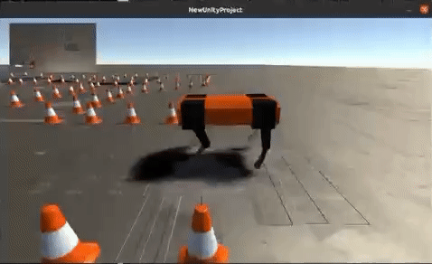
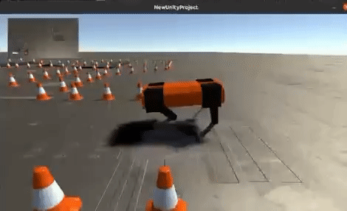
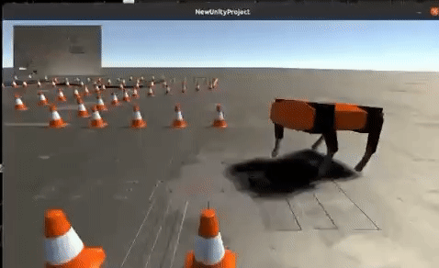
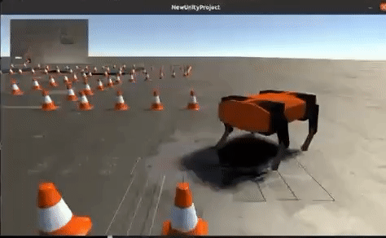
Controller -- Modes
Walking as a normal dog
Walking when its designer is super lazy
counterclockwise rotation
clockwise rotation
Introduction to ROS| Team 28

Slide 9
Need to be improved..
How to recognize a step\sloper -> Use OccupancyGird
Sometimes path planning failed -> Adjusting the move_base parameter
Introduction to ROS| Team 28

